Slide 1
STACKS

Slide 2

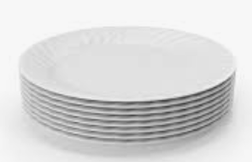
STACK
Stack is a linear data structure in which insertion and deletion is always done from one end known as top of stack (TOS).
In stack both insertion and deletion are done from TOS.
The item inserted in last is deleted first.
It is also known as LIFO (Last in first out).
Example: Stack of plates, stack of books

Slide 3
OPERATIONS ON STACK
Push- Insertion of an item into stack is known as push operation.
Pop- Deletion of an item from stack is known as pop operation.
Traverse- Displaying the items of stack.
Note: All the operations on stack is done from top.

Slide 4
STATIC IMPLEMENTATION OF STACK
Insertion: TOS increases in insertion.
TOS=1
20
TOS=0
10
10
TOS=-1
TOS=3
40
TOS=2
30
30
20
20
10
10

Slide 5
STATIC IMPLEMENTATION OF STACK
Deletion: TOS decreases in deletion.
TOS=3
40
30
TOS=2
30
20
20
TOS=1
20
10
10
10
TOS=0
10
TOS=-1

Slide 6
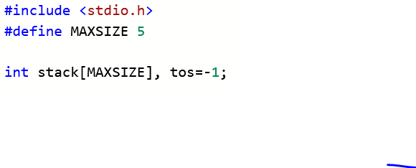
STATIC IMPLEMENTATION OF STACK

Slide 7
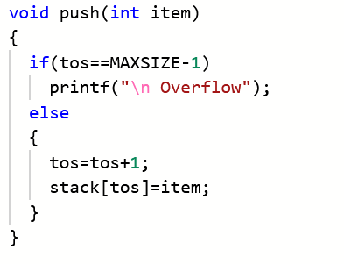
PUSH OPERATION

Slide 8
POP OPERATION
int pop ()
{
int item=0;
if(tos==-1)
printf(“Underflow”)
else
{
item = stack[top]
tos- -
}
return(item)

Slide 9
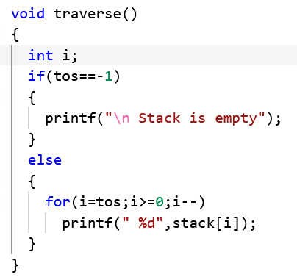
TRAVERSE OPERATION

Slide 10
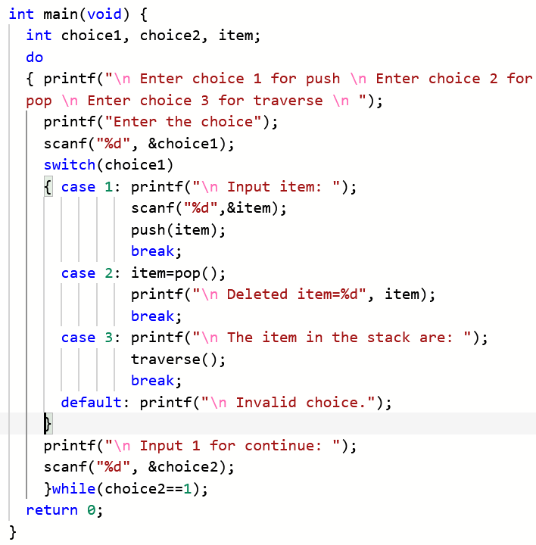

Slide 11
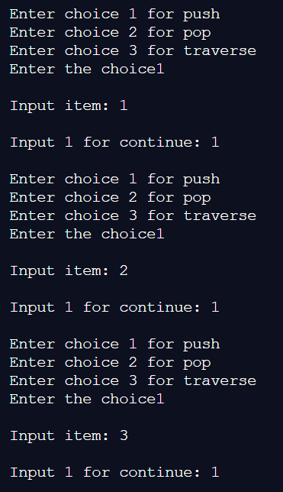

Slide 12
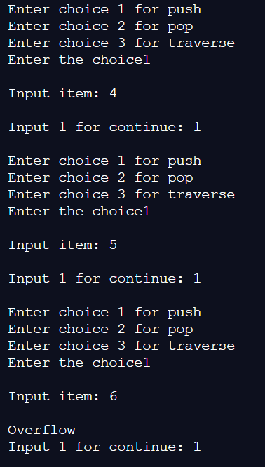

Slide 13
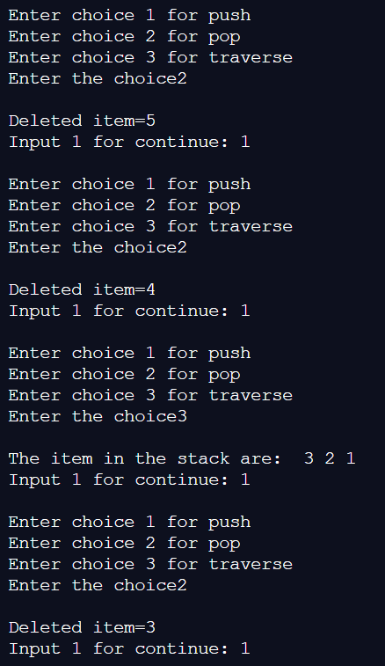

Slide 14
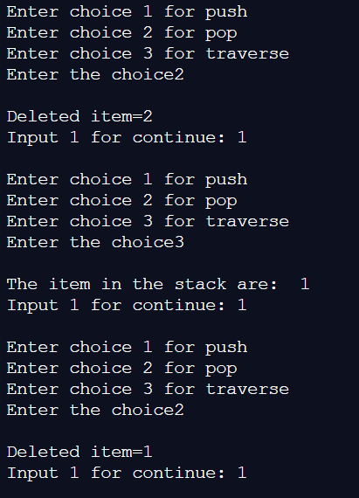

Slide 15
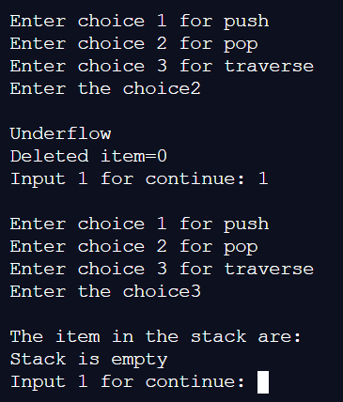

Slide 16
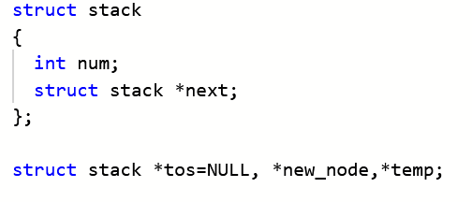
DYNAMIC IMPLEMENTATION OF STACK
Here the stack is implemented like singly linked list.

Slide 17
INSERTION
Initially TOS=NULL
After insertion of first node.
After insertion of second node.
After insertion of third node.
100
1
NULL
tos
100
200
2
100
200
tos
1
NULL
100
300
3
200
300
tos
2
100
200
1
NULL
100

Slide 18
DELETION
300
3
200
300
Lets the stack is:
The deletion will be from TOS.
tos
2
100
200
1
NULL
100
200
2
100
200
tos
1
NULL
100

Slide 19
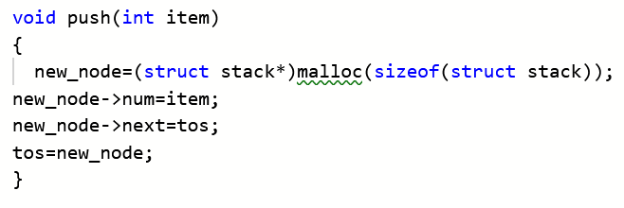
PUSH OPERATION

Slide 20
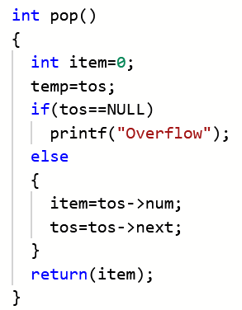
POP OPERATION

Slide 21
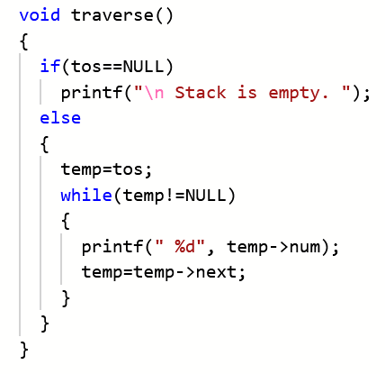
TRAVERSE OPERATION

Slide 22
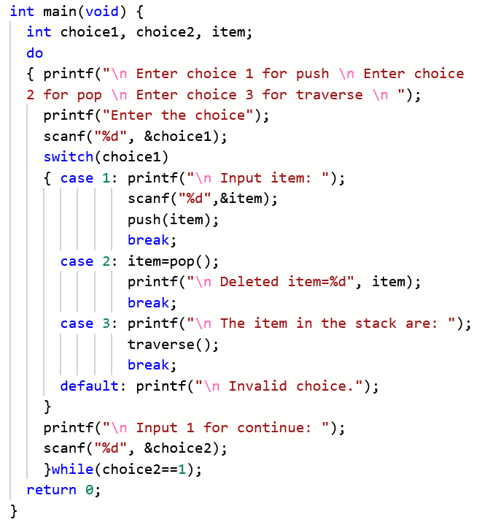

Slide 23
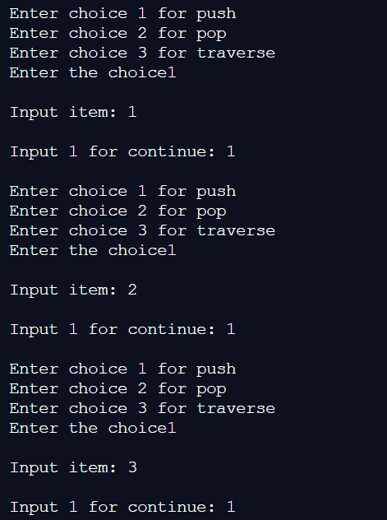

Slide 24
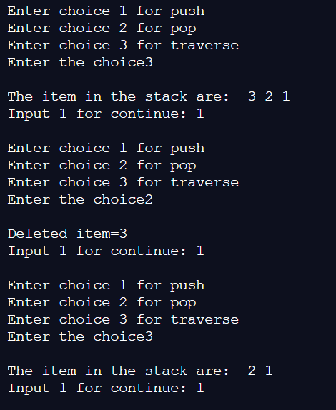

Slide 25
